Slide 1
The HDF Group
Company, Services and Products

Slide 2
Outline
The HDF Group company
Products and services
Current and new directions
HDF5 update
HDF5 software evolution

Slide 3
The HDF Group company

Slide 4
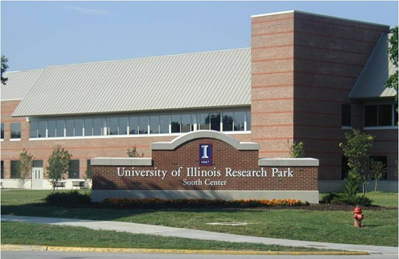
Champaign, Illinois, USA

Slide 5
The HDF Group
www.hdfgroup.org
Not-for-profit company (since 2006), ex-NCSA at University of Illinois
About 40 employees (more than 50% growth in the past 6 years)
Mission-driven
Sustainable development of HDF technologies
Guarantee continual accessibility of HDF data

Slide 6
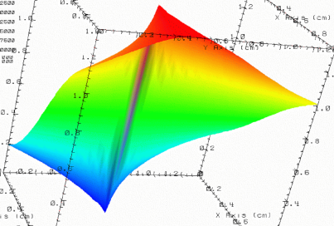



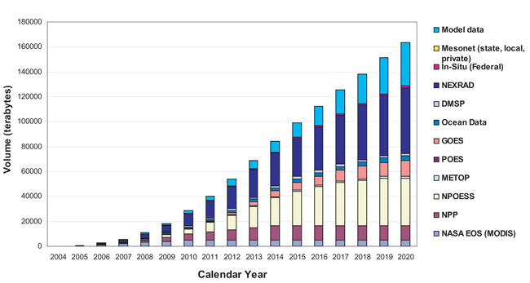
Data challenges addressed by HDF
Need to organize complex collections of data
lat | lon | temp
----|-----|-----
12 | 23 | 3.1
15 | 24 | 4.2
17 | 21 | 3.6
Experiment Notes:
Serial Number: 99378920
Date: 3/13/09
Configuration: Standard 3
Long term data preservation
Efficient, scalable storage and access

Slide 7
The HDF Group philosophy
Committed to Open Source
HDF software is free
BSD type of license
Community involvement
Testing
Patches
New features (e.g., CMake support)
Serving diverse user base
Remote sensing, HPC, non-destructive testing, medical records, scientific modeling, etc.

Slide 8













Members of the HDF community
Notes:
NASA – EOS
NOAA/NASA/Riverside Tech – NPOESS/JPSS
A leading U.S. aerospace company
DOE projects
Sandia National Laboratory
Lawrence Berkeley National Lab
Argonne
ITER – international project to build an experimental fusion reactor based on the tokamak concept
Paul Scherrer Institute – variety of projects
Projects in oil and gas industry, finance, others
“In kind” support

Slide 9
Revenues by source

Slide 10
Products and services

Slide 11
The HDF Group products
Main product: HDF Technology Suite
For managing high volume complex, heterogeneous data
Flagship: HDF5 data store
Flexible and efficient storage and I/O
Portable
Highly customizable
Misc. tools
Specialized software and tools (e.g., JPSS)

Slide 12
The HDF Group services
Helpdesk and mailing lists
help@hdfgroup.org
hdf-forum@hdfgroup.org
Open to all users of HDF

Slide 13
The HDF Group services
Standard support
Assistance in general areas of HDF usage
Premium support
Access to our consulting and training resources
Limited consulting hours are included
Enterprise support
Help with developing common strategies for managing HDF data within organization
Organization shares consulting/troubleshooting services
Training
Consulting and custom development
Notes:
Standard Support: (package pricing TBD)
Standard Support is offered for organizations that need a modest level of high quality, high priority assistance in general areas of HDF usage.
Priority issue acknowledgment within one business day
Assistance with software installation, API usage, and documentation questions
Access to feature/bug tracking database
Patch releases
Eligibility to register for user workshops
Premium Support: (package pricing TBD)
Premium Support options are available for organizations that desire high quality, high priority assistance plus enhanced access to our consulting and training resources. This level of support includes all benefits of Standard Support plus:
12 hours of consulting services
Discount on daily training rates
Monthly 30-minute teleconferences
Reduced registration fee for user workshops
Enterprise Support: Contact us for pricing
Enterprise Support options are for organizations making a substantial, organization-wide commitment to HDF, and these relationships can be customized to focus on specific needs. In addition to providing all benefits of Premium Support, Enterprise Support allows businesses to:
Coordinate HDF activities across departments
Share consulting/troubleshooting options
Combine training and development resources
Develop common strategies for managing HDF data
Share HDF-based applications and tools
Assure continuing support for HDF in your organization
Training: Contact us for course development and pricing
Training courses may be conducted at The HDF Group headquarters, at a site of your choosing, or remotely. Courses can be customized to your needs and may include topics ranging from an introduction to HDF to advanced topics such as advanced software development using HDF, tuning your application to improve performance, and using HDF effectively on parallel systems. Training may include tutorials and hands-on practical experience. All travel costs for instructors are in addition to the training costs.
Consulting and Custom Development: Contact us for project planning and pricing
The HDF Group encourages you to contact us to discuss specific consulting needs or project specifications. We offer a number of options for creating individualized relationships and agreements with our customers. Consulting and special projects cover topics such as:
Adapting your applications to HDF
Adding new features to the HDF libraries and tools
Support for new programming languages
Implementing new tools
Performance tuning
Porting HDF to a specific platform
Regular teleconferences and onsite work
Special projects are priced individually, depending on staffing requirements, equipment, travel, and other factors.
Is this a private area for just their bugs, or access to the general issue tracking in Jira? I think our plan has been to make the general bugs publicly visible (like most other open source packages)…

Slide 14
Success stories
Petabytes of NASA remote sensing data in HDF4 and HDF5 file formats
New NASA/JPSS missions chose HDF5 format for data archiving
Parallel I/O
Trillion particle plasma physics simulation on 120000 cores
Writes to a single, shared 30 TB HDF5 file
Peak I/O rates ~35GB/s
Average rate ~23GB/s

Slide 15
Current and new directions

Slide 16
Current and new directions
Maintenance and HPC development
HDF5 Information set
HDF5 and Web services
HDF5 and integration with DBMS
HDF5 PowerShell
HDF5 XML shema

Slide 17
Maintenance: Issues and their priorities
Must Fix
Data corruption
Portability
Backward and Forward Compatibility
Funded request
Fix after “Must Fix”
Power User Request
Tools
Library issues
Build Infrastructure
When resources permit
Wrappers
HL Libraries
Other
Need your input on priorities!
Notes:
This is how we decide which issues to fix first.

Slide 18
High performance computing (HPC)
HDF5 is one of the most popular file formats in HPC
Recent statistics from DOE centers
 | Machine 1 |  | Machine 2 |  | Machine 3
 | Instances | Users | Instances | Users | Instances | Users
hdf5 | 6500 | 126 | 15700 | 167 | 4742 | 50
netcdf | 3500 | 61 | 63000 | 159 | 2769 | 43
pnetcdf | 320 | 6 | 12500 | 36
adious | 2800 | 3 | 3500 | 30

Slide 19
High performance computing (HPC)
High-performance I/O, both serial & sequential
Misc. projects with DOE labs
Swiss National Supercomputing Center (CSCS)
New direction:
Data-intensive peta- and exascale computing

Slide 20
HDF5 Information Set
“Language shapes the way we think, and determines what we can think about.”
(Benjamin L. Whorf)
Is a model of the content of an HDF5 file
Provides a consistent set of definitions
Gives an undistorted view of HDF5*
Puts the simplicity of HDF5 center stage
*Not tainted by the idiosyncrasies of a particular API

Slide 21
Before: HDF5 Data Model
lat | lon | temp
----|-----|-----
12 | 23 | 3.1
15 | 24 | 4.2
17 | 21 | 3.6
An HDF5 file is a container that holds data objects.
Experiment Notes:
Serial Number: 99378920
Date: 3/13/09
Configuration: Standard 3

Slide 22
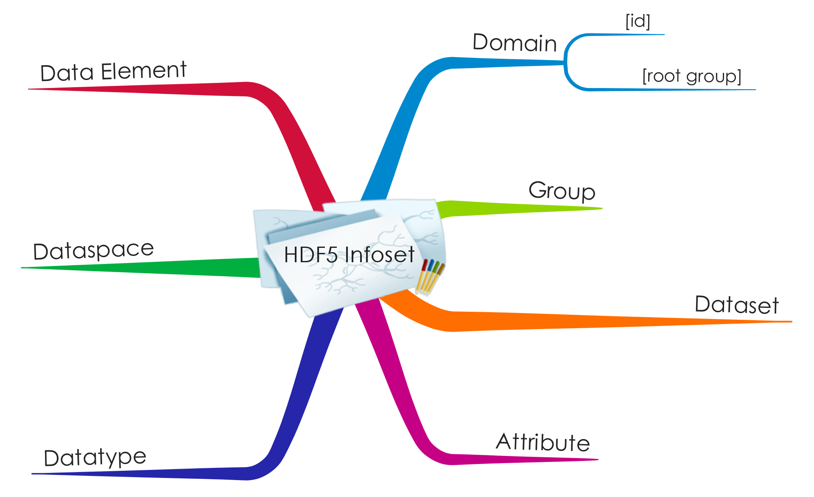
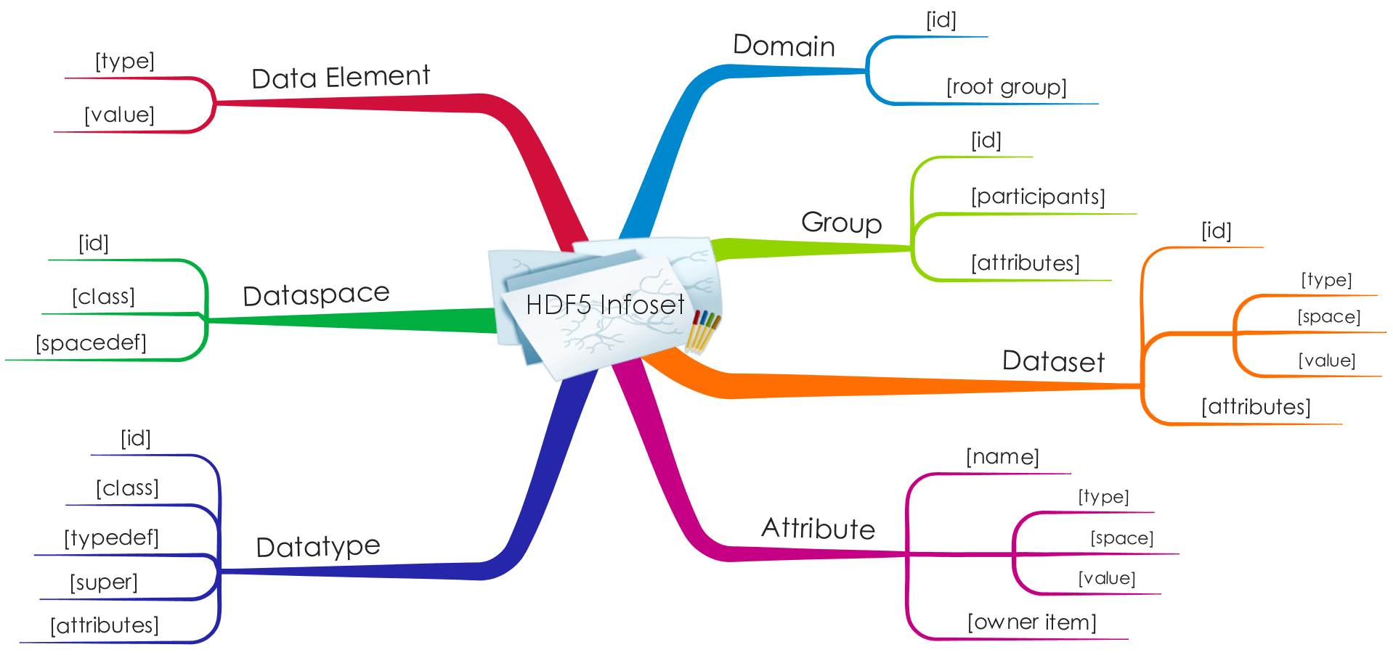
After: HDF5 Information Set

Slide 23
Web Services
OPeNDAP
A software framework that allows simple access to remote data
Client-server model
Servers make the local data accessible remotely
Clients make applications easily access to remote served data
Widely used by Earth Science Community
URL: http://www.opendap.org

Slide 24

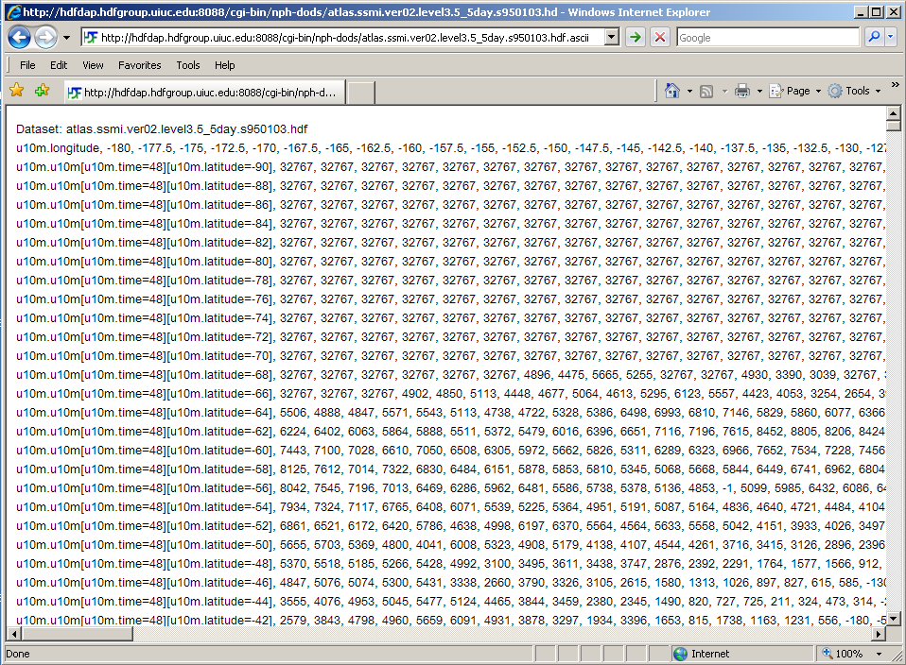
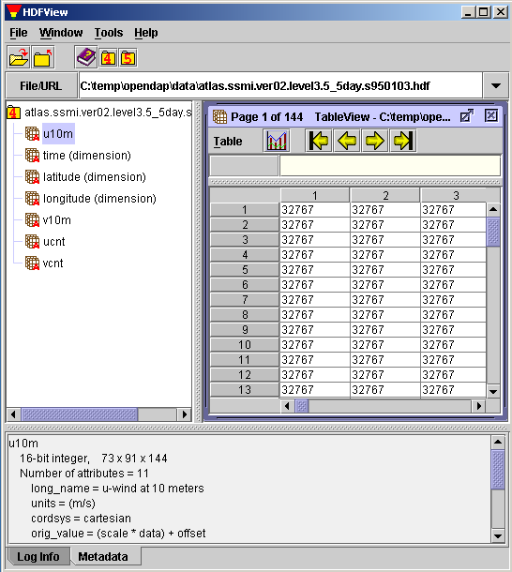
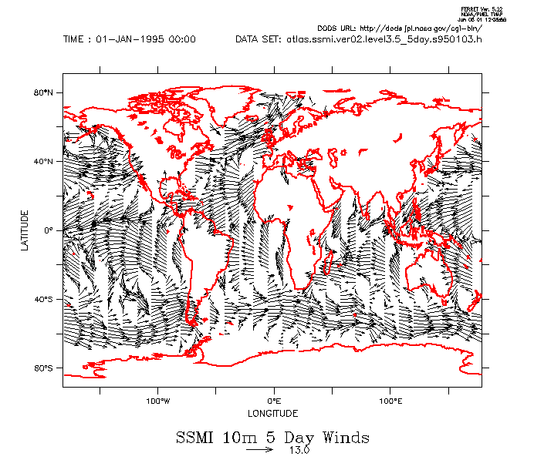
OPeNDAP Concept
Typical Remote Access
View Data
(User)
FTP/HTTP
Remote Data
(HDF4/5)
Visualization Tools
(gradsdap)
Visualization tools
(e.g., grads)
Handler
(hdf4/5_handler)
Client Library
(libnc_dap)
Server
(Hyrax)
Data Access Protocol (DAP) via Internet
Notes:
This is how remote data can be accessed via OPeNDAP. Normally, users can view local data file using scientific data using visualization tools like GrADS. In DAP, this can be done for remote file. First DAP provides both generic server and client. For different data format like HDF and NetCDF, it needs an additional server that can map such data into a standard DAP format.
Next, by modifying the existing visualization tools to adopt OPeNDAP client library, they can show the remote data on demand.
The benefit of OPeNDAP is clear when you want to view a small dataset; you don’t have to download the entire data from the server.
DAP is a low-level medium that implementers can impose any additional restrictions on top of DAP model.
The bottom line is that web browser can access any HDF data.

Slide 25
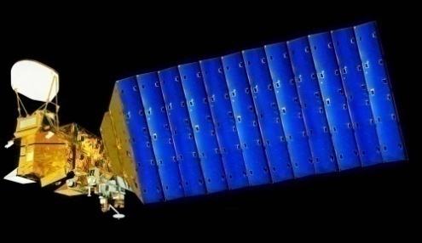

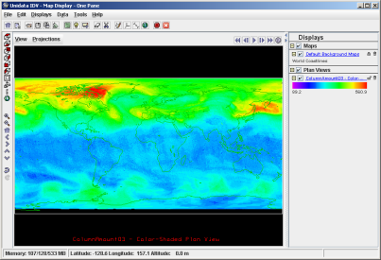

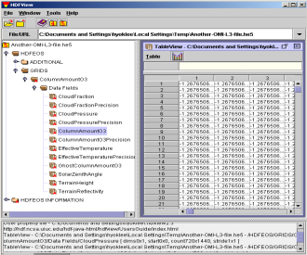
Access HDF via OPeNDAP
Aqua/Aura
Users
Hyrax
IDV
libnc-dap
HDF HANDLER
AIRS/OMI
DAP
Visualization
Tools
OPeNDAP
Clients
OPeNDAP
Servers
HDF Files
Notes:
OPeNDAP is an open implementation of easy data access through visualization tools like IDV.
Our work bridges the existing OPeNDAP framework and HDF so that visualization is possible over the Internet.

Slide 26
Web Services
New directions:
HDF5’s role in the cloud
HDF5 REST interface
Windows Azure prototype
If interested contact Gerd Heber
gheber at hdfgroup dot org

Slide 27
HDF5 integration with DBMS
Long-standing request
Examples of custom solutions
HDF-EOS DataBlade using Informix
Aberdeen Test Center

Slide 28
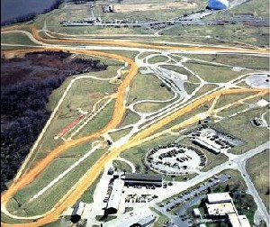

Aberdeen Test Center

Slide 29
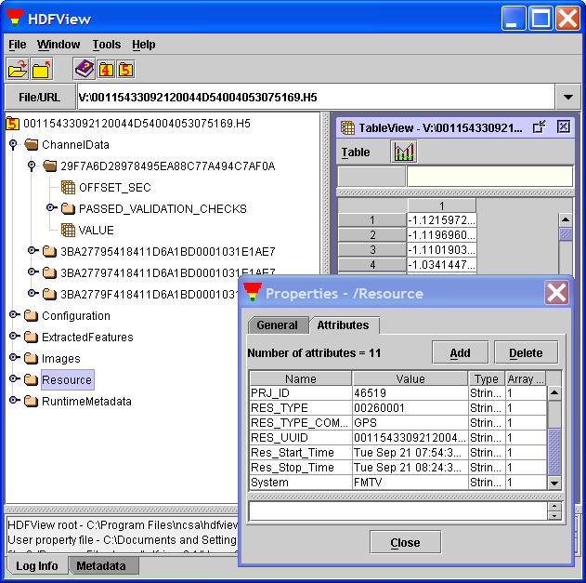
HDF5 “File system”

Slide 30
Engineering Units Database

Slide 31
Database
and
HDF5 File System
Data

Slide 32
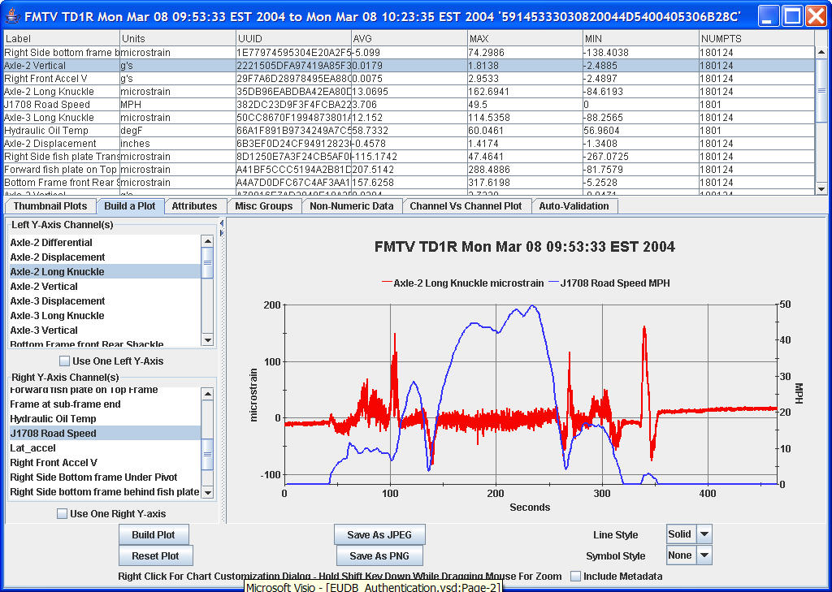
Custom tool to analyze data

Slide 33
HDF5 and DBMS
Three significant developments:
Arrays can be first class citizens
Database file systems offer the potential to store Level 0 data and analyze Level 1 and Level 3 data within the same DBMS
All vendors (IBM, Microsoft, Oracle) have rolled out BigData connectors
Databases have morphed into data hubs.
We are working hard to get HDF5 connected!

Slide 34
Other directions of interest
PSH5X - A Windows PowerShell Module for HDF5
http://www.hdfgroup.org/projects/PSH5X/
New HDF5 XML schema
http://www.hdfgroup.org/HDF5/XML/schema/2011/11/11

Slide 35
Why another schema?
Address shortcomings
Omissions
Eliminate redundancies
De-normalized group structure representation
Dataset and attribute value serialization
Simplify tools
Reflect simplicity of the HDF5 data model
High-fidelity representation
Be neutral with respect to application domains
Future proofing

Slide 36
High-Level Structure
<domain xmlns=“http://www.hdfgroup.org/HDF5/XML/schema/2011/11/11”
xmlns:xlink=“http://www.w3.org/1999/xlink”>
<!-- “Pointer” to the HDF5 root group -->
<root xlink:href=“903d1d75-e617-4767-a3bf-0cb3ee509027”/>
<linkbase>
<!–- Representations of HDF5 groups -->
</linkbase>
<database>
<!–- Representations of HDF5 datasets -->
</database>
<encodingbase>
<!-- Collection of representations of HDF5 datatypes -->
</encodingbase>
</domain>

Slide 37
HDF5 Update

Slide 38
HDF5 status
Dropped support for HDF5 1.6.* in November 2009
Last release HDF5 1.6.10
HDF5 1.8.9 released on May 15, 2012
Maintenance releases are every 6 month
November and May
Bug fixes, new features that do not require file format change
Major new release in works 1.10.0

Slide 39
Recent releases highlights
Allow dimension size to be 0 (no data can be written)
Improved performance by allowing caching files open through external links
Added support for Fortran 2003
Create and read in-memory HDF5 files without requiring I/O operations
Many improvements to tools: h5diff, h5dump, h5repack

Slide 40
Command-line utilities improvements
h5dump
Support for wildcard in the filename
h5repack
100x speedup for some cases involving chunking
h5diff
Options to show different levels of information
A flag to exclude objects from comparison
Notes:
Major quality improvements:
h5dump
Major code refactoring
Remove duplicated functions and other defects.
Show correct value for H5T_STD_I8LE dataset on big-endian systems
h5diff
Fix segmentation faults
Correct “--delta" option on two NaN of the same type are different, which is wrong
Compare file itself correctly if the file is empty or contains non-comparable objects
Fix memory leaks
Double the performance for compound datasets
Handle variable-length strings in a compound dataset correctly
Compare member objects and groups recursively when two files or groups are specified
h5repack
Fix memory leak for handling variable length string in attribute
Update values of references (object and region) of attributes
Handle memory allocation failure inside the library
Fix problem if the layout is changed from chunked with unlimited dims to contiguous
Convert a layout to COMPACT for small size dataset as default
h5ls
Fix segmentation fault when access region reference data in an attribute
h5copy
Allow to copy any object into the same HDF5 file

Slide 41
HDF Software Evolution
GMQS Activities

Slide 42
HDF5 software evolution themes
Concurrent access
Real-time write performance
Metadata aggregation and buffering
AIO
Virtual Object Layer
Topics above will be covered tomorrow

Slide 43


New features in HDF5 1.10.0
Saving space (development completed)
Persistent File Free Space tracking/recovery (1.10.0)
Saving time (taking more time)
Asynchronous I/O
Allow an application to proceed while the HDF5 library performs I/O (1.10.0)
Notes:
43
Notes about AIO:
As long as the file system is POSIX compliant
Other processes can be on other systems (as long as shared file system is POSIX compliant)

Slide 44


New features in HDF5 1.10.0
Saving files when disaster strikes
Journaling
Journal metadata changes saved in a file
h5recover tool to restore metadata in a file
Single Writer/Multiple Readers (SWMR)
Allows simultaneous reading of HDF5 file while the file is being modified by another process
h5watch tool completed
Provides fault tolerance aspects for a file; if writer crashes the file is in the consistent state.

Slide 45
New features in the works
By popular demand:
Object compare API and tool
Based on a formal definition of the HDF5 objects comparison
Avoids ambiguity and features creep (as with h5diff)
Emphasis on flexibility and efficiency
Control over reporting “differences”
Compare compressed data without uncompressing it

Slide 46
Thank You!
Questions?

